Slide 1

#NERCOMP23

Slide 2

Experiences Using SakaiPlus with Canvas at University of Michigan
`
#NERCOMP23

Slide 3

SakaiPlus TL;DR
Plugs an entire LMS into an Enterprise LMS with a single link
Rosters and Grades are synchronized using LTI Advantage
Cost and IT Support are on par with a single LTI Tool
Give your innovative faculty a choice
#NERCOMP23

Slide 4
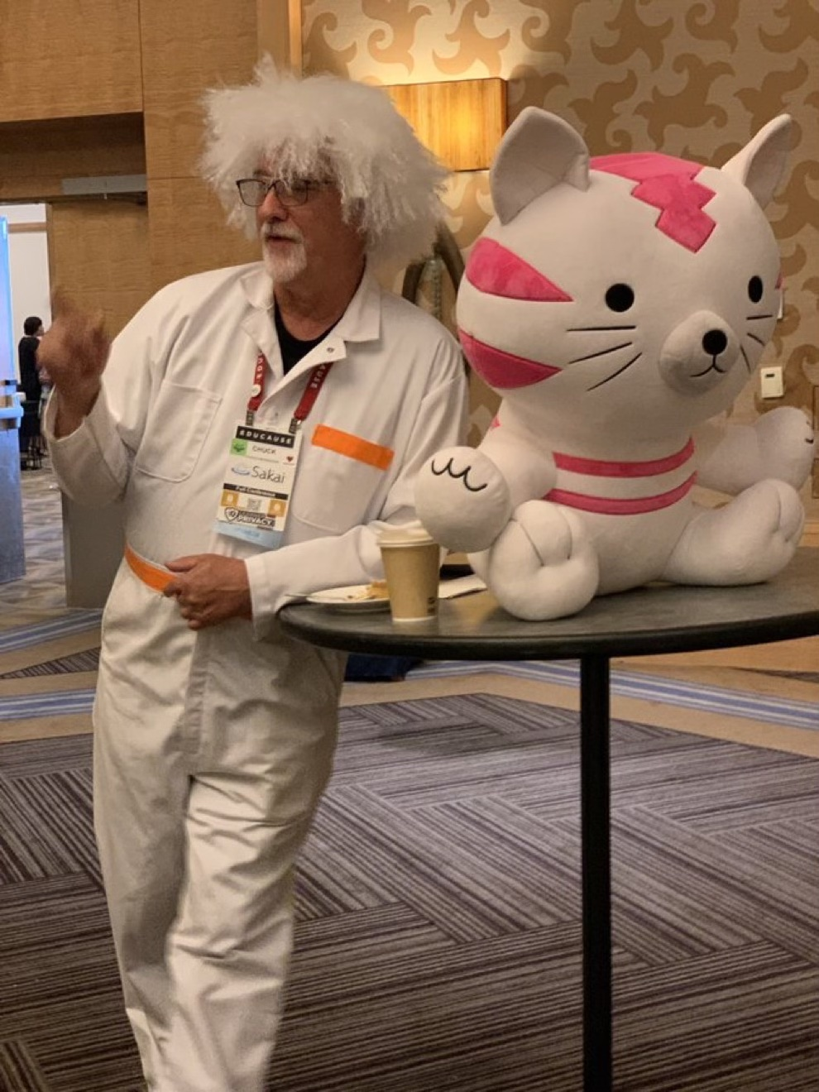
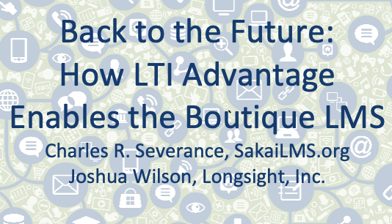
One Year Ago
#NERCOMP23

Slide 5
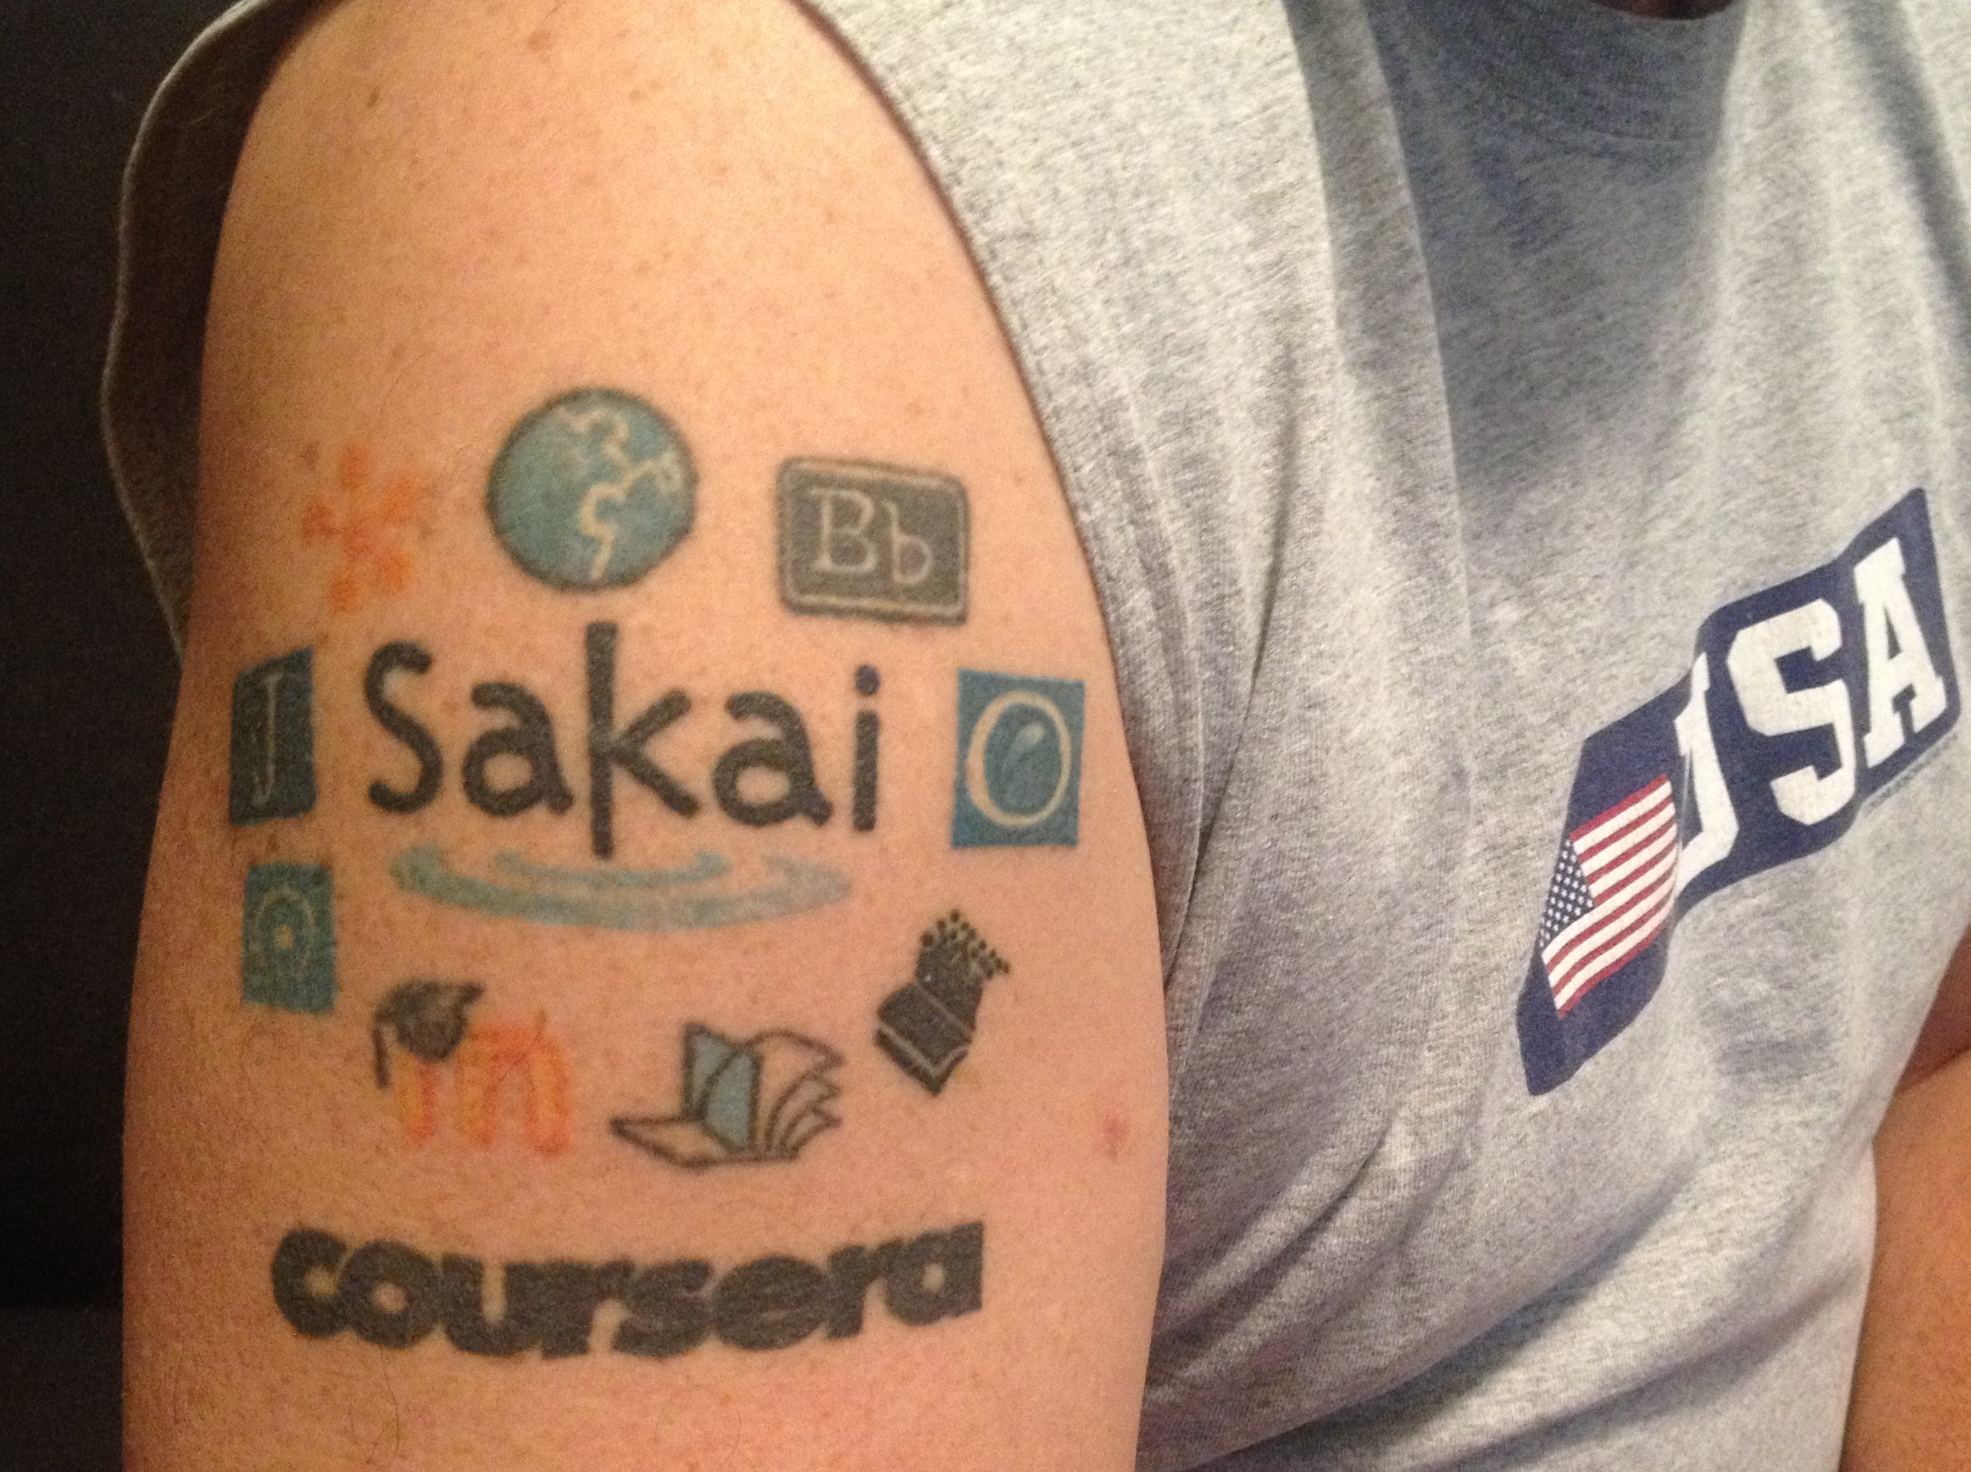
Dr. Chuck
Co-Founder Sakai 2004
Founded Learning Tools Interoperability (LTI) 2004
Founded Common Cartridge (2006)
Faculty member University of Michigan School of Information 2007-present
MOOC Innovator – Coursera 2014
Current Chair of the Sakai PMC
#NERCOMP23

Slide 6
SakaiPlus @ University of Michigan
Initial Development and Testing – 2021
Summer 2022
Approval for limited production use in the School of Information
Privacy training
Hosted on UMich-owned AWS resources
Fall 22 – Sakai 22+Beta – One Course
Winter 23 – Sakai 23+Beta – Three Courses
Summer 2023 – Released in Sakai 23
#NERCOMP23

Slide 7
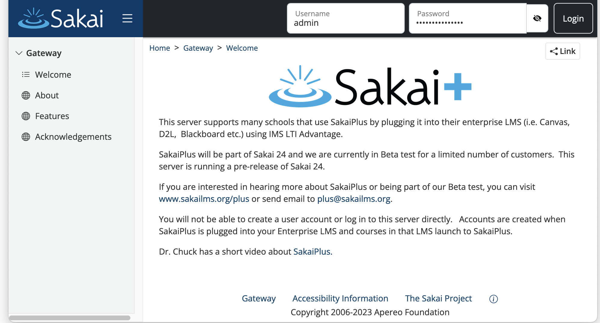
https://plus.sakaicloud.com – Beta Ready
#NERCOMP23

Slide 8
SakaiPlus Philosophy
No local customization
Easy Upgrades
AMI Subscription
#NERCOMP23

Slide 9
Living inside the Enterprise LMS
Upgrade early and often – track the latest
Less concern regarding performance and scaling
No standup meetings ☺
Always can fall back to the enterprise LMS – Hybrid (Screen shot of modules - from Fall 23)
#NERCOMP23

Slide 10
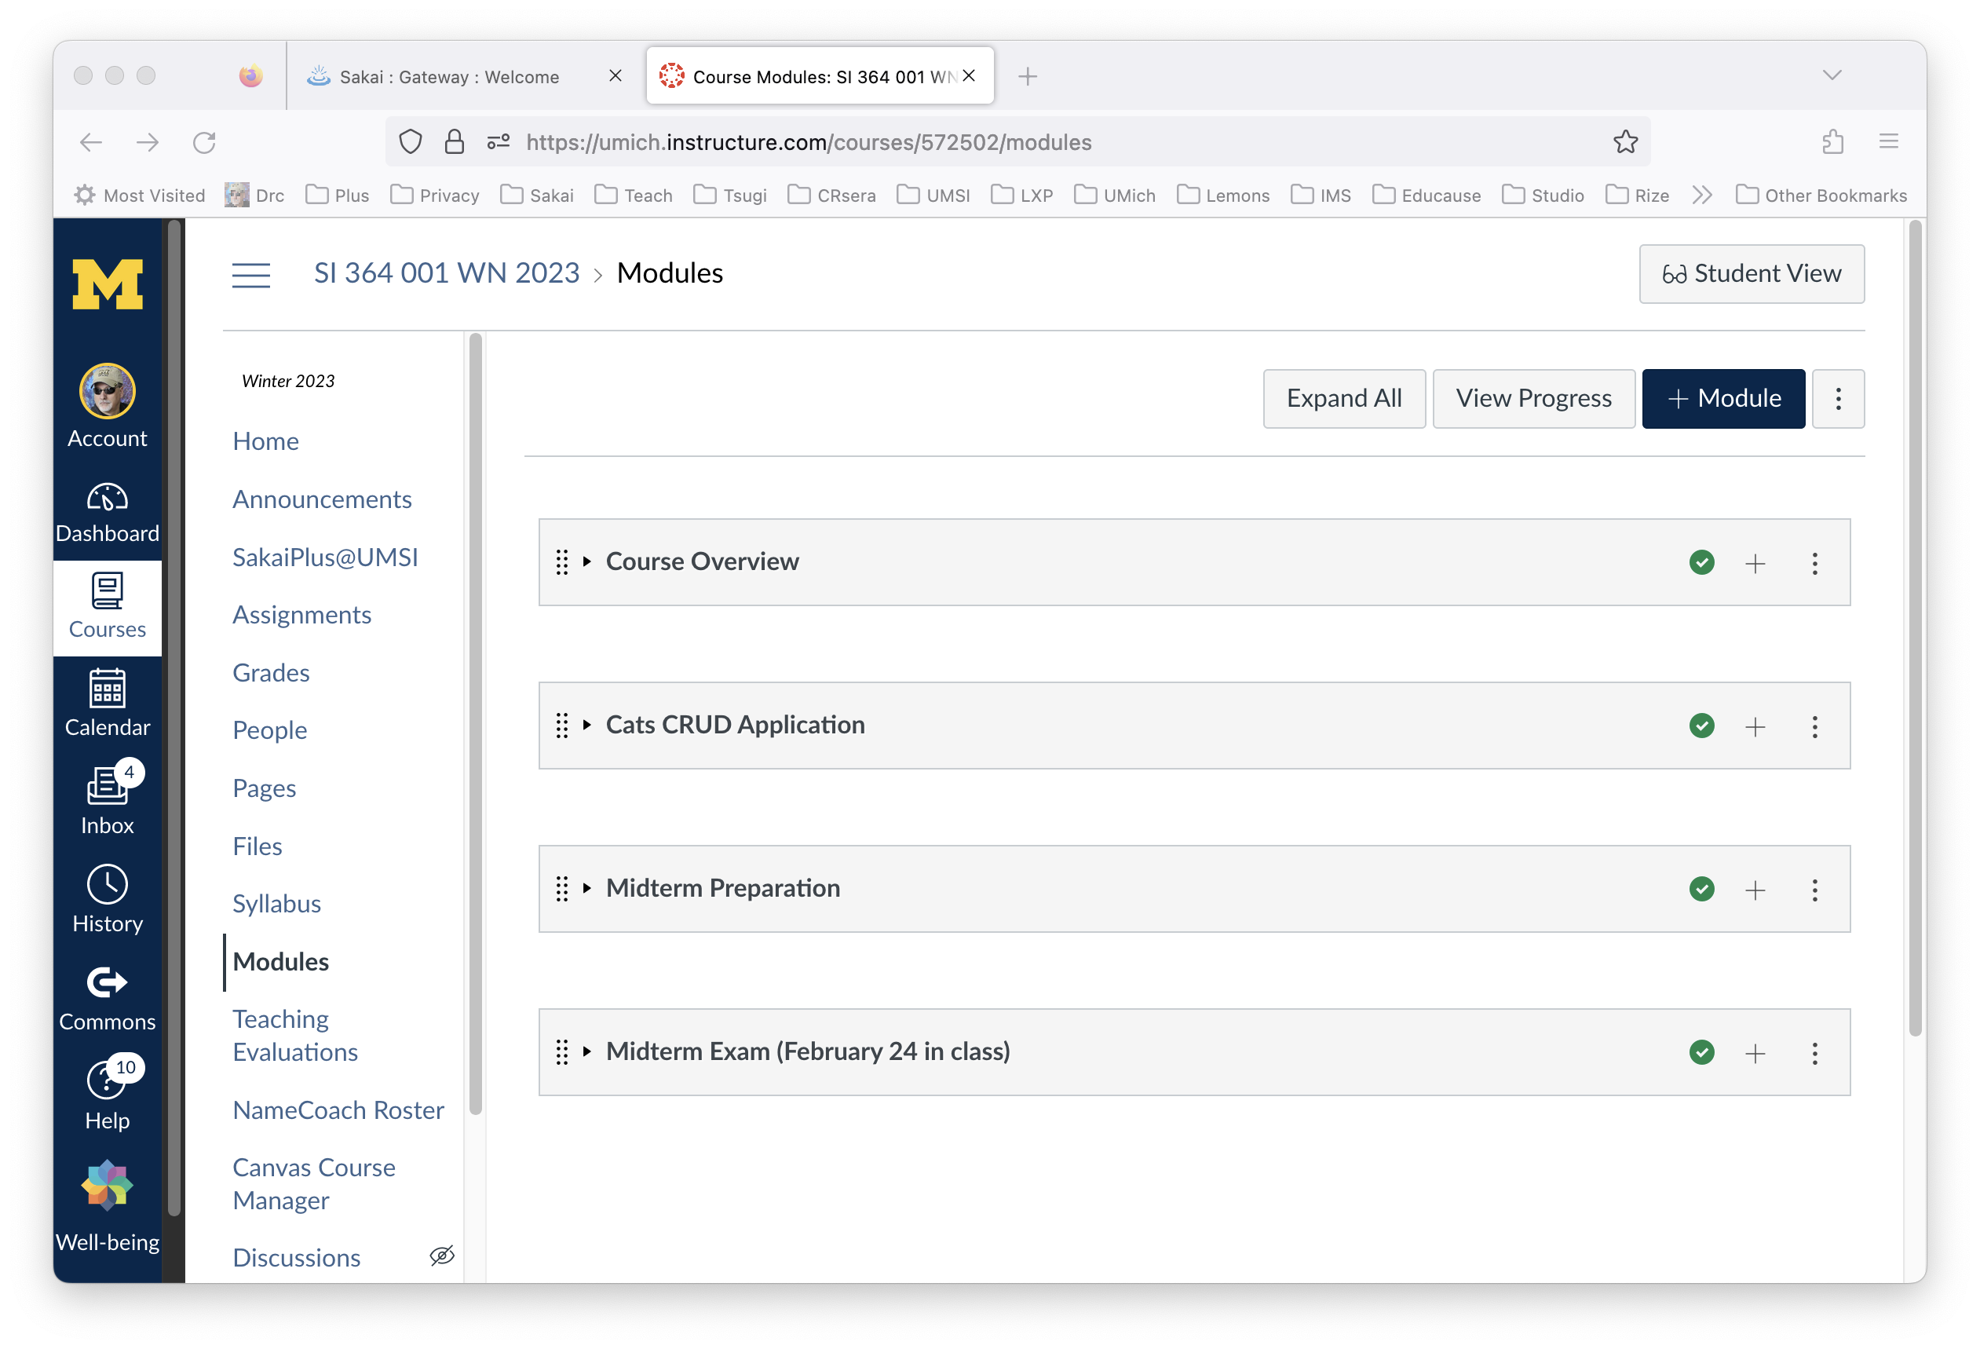
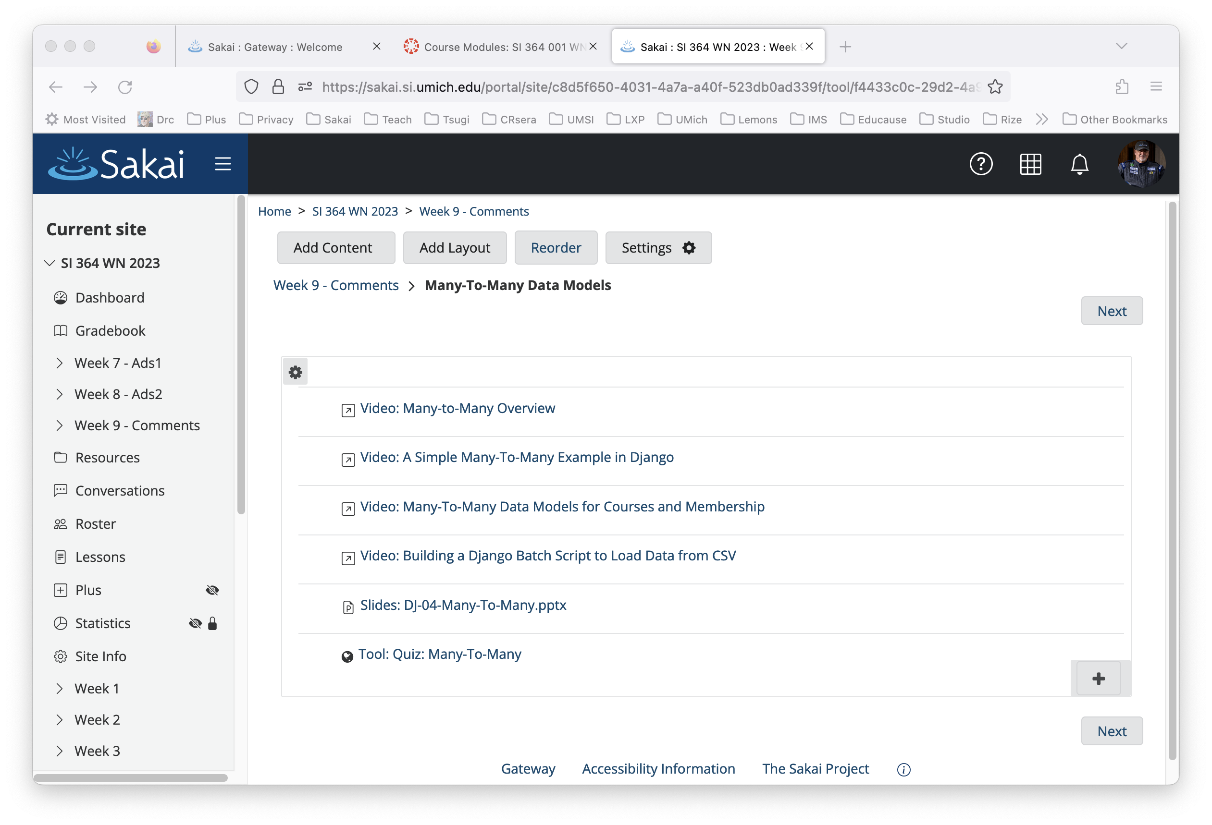
#NERCOMP23

Slide 11
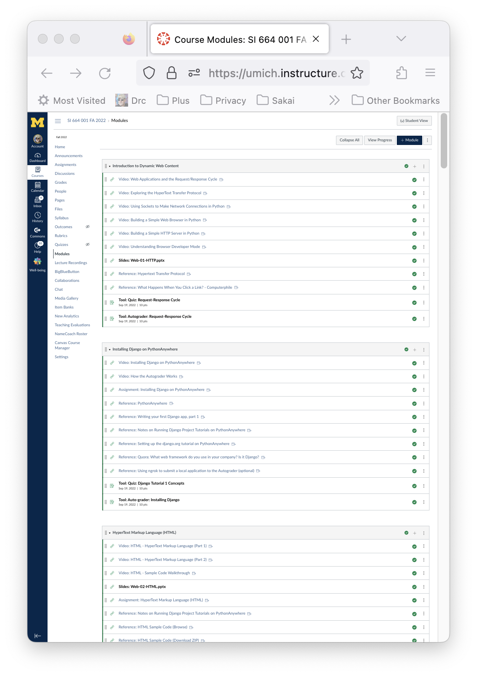
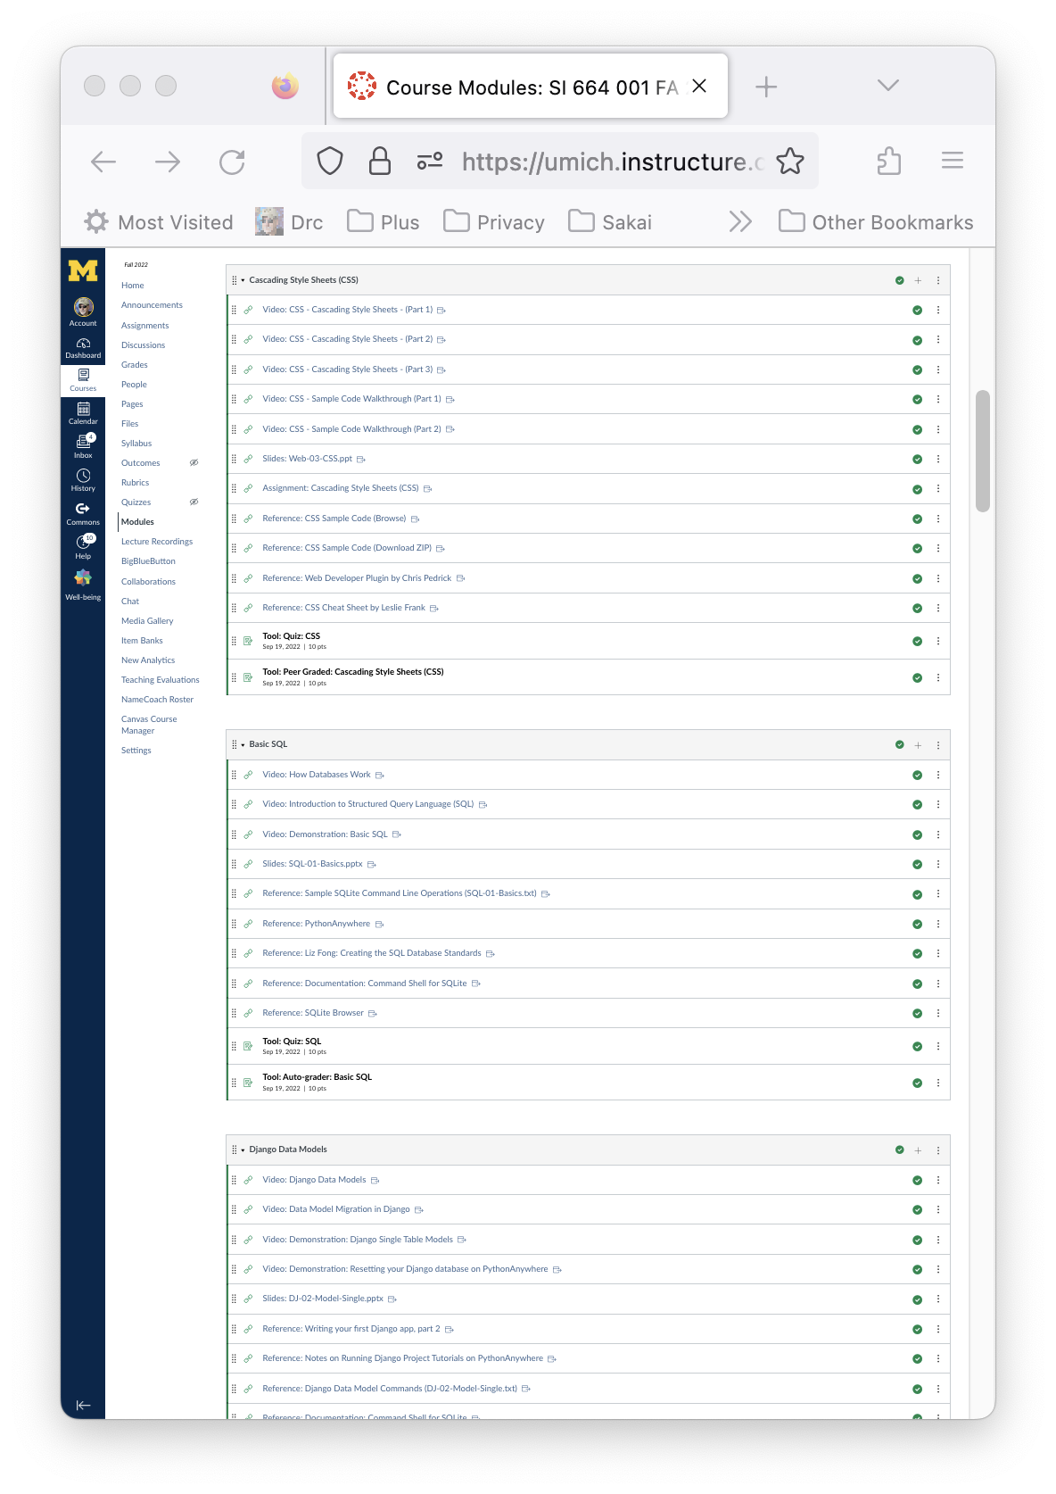
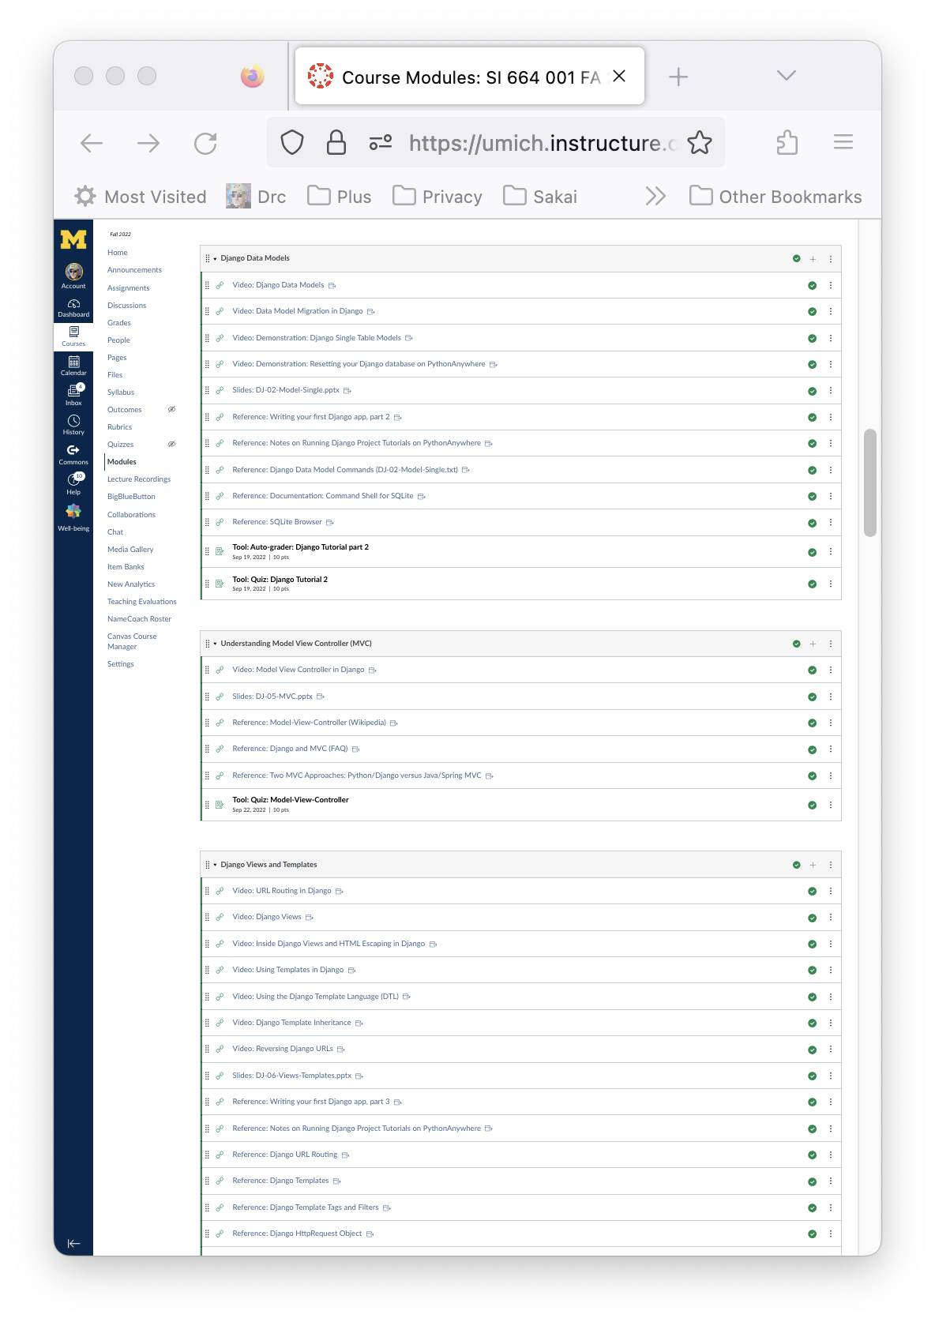
My Fall 22 Modules in Canvas (1/3)
#NERCOMP23

Slide 12
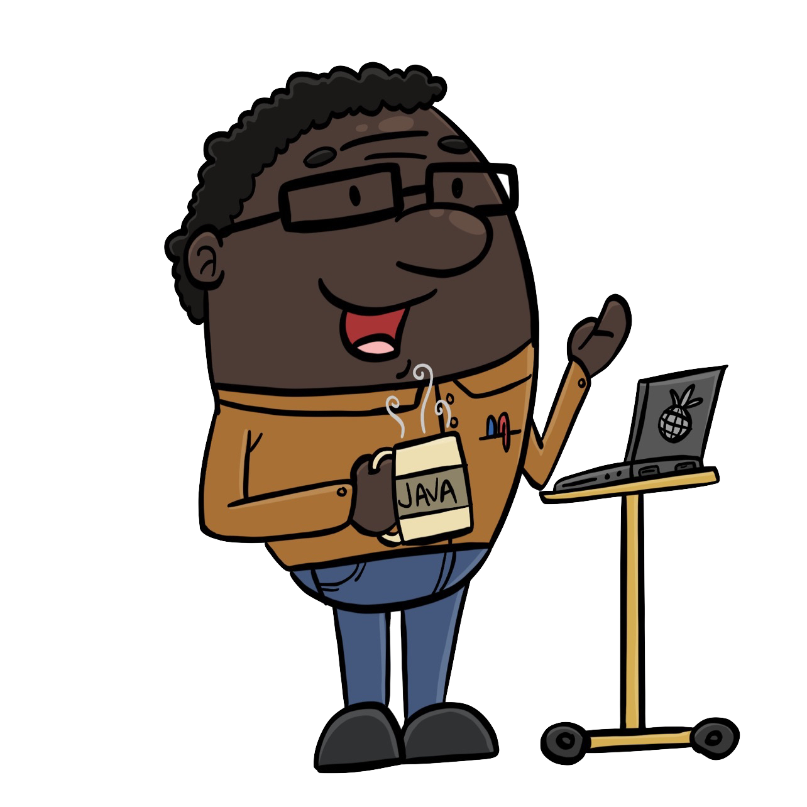
Campus IT Perspective
From the Campus IT perspective, this is a single LTI tool
The "new vendor" meetings 3-4 hours Summer 2033
Help with the integration (1 hour back in Sept 2022)
Happy faculty member
#NERCOMP23

Slide 13
Demo
#NERCOMP23

Slide 14

Instructor Perspective
I am teaching the way I like
I have much more control over the student UX because of Lessons
I am not stuck in an LMS that will never change or grow.
#NERCOMP23

Slide 15

Student Perspective
Zero complaints
Students picked it up right away
They use resources outside the LMS across many classes - this was like a publisher site associated with a book
They even used Sakai features like the Tasks tool
#NERCOMP23

Slide 16
My Future Research > 1 LMS
My goal is to pave the way for multiple LMS systems on a campus
I am adding a light LMS capability my Tsugi Learning Object Repository so can teach right in my learning object repository
I am working with a grad student and trying to convince her to build a prototype Virtual Reality LMS and plug it in using LTI Advantage
#NERCOMP23

Slide 17
Summary
More information
Plus @sakailms.org
Beta server
https://plus.sakaicloud.com
Let's do some beta testing over the summer.
#NERCOMP23

Slide 18

`
SakaiLMS Great for Learning
#NERCOMP23

Slide 19
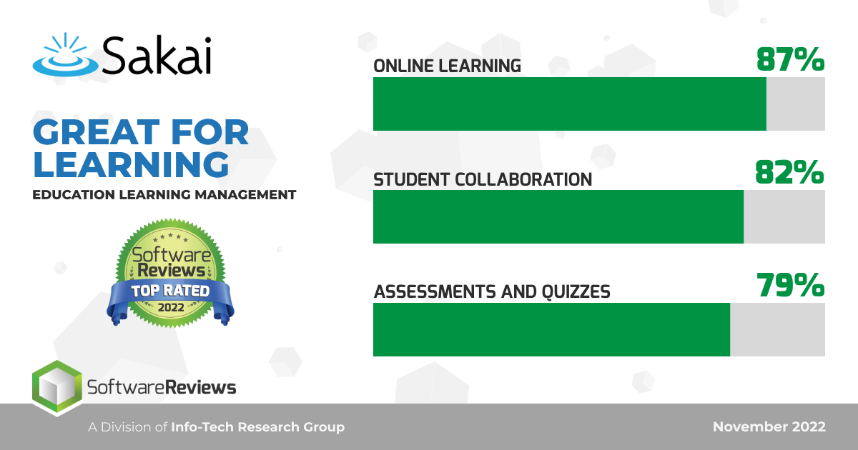

Slide 20
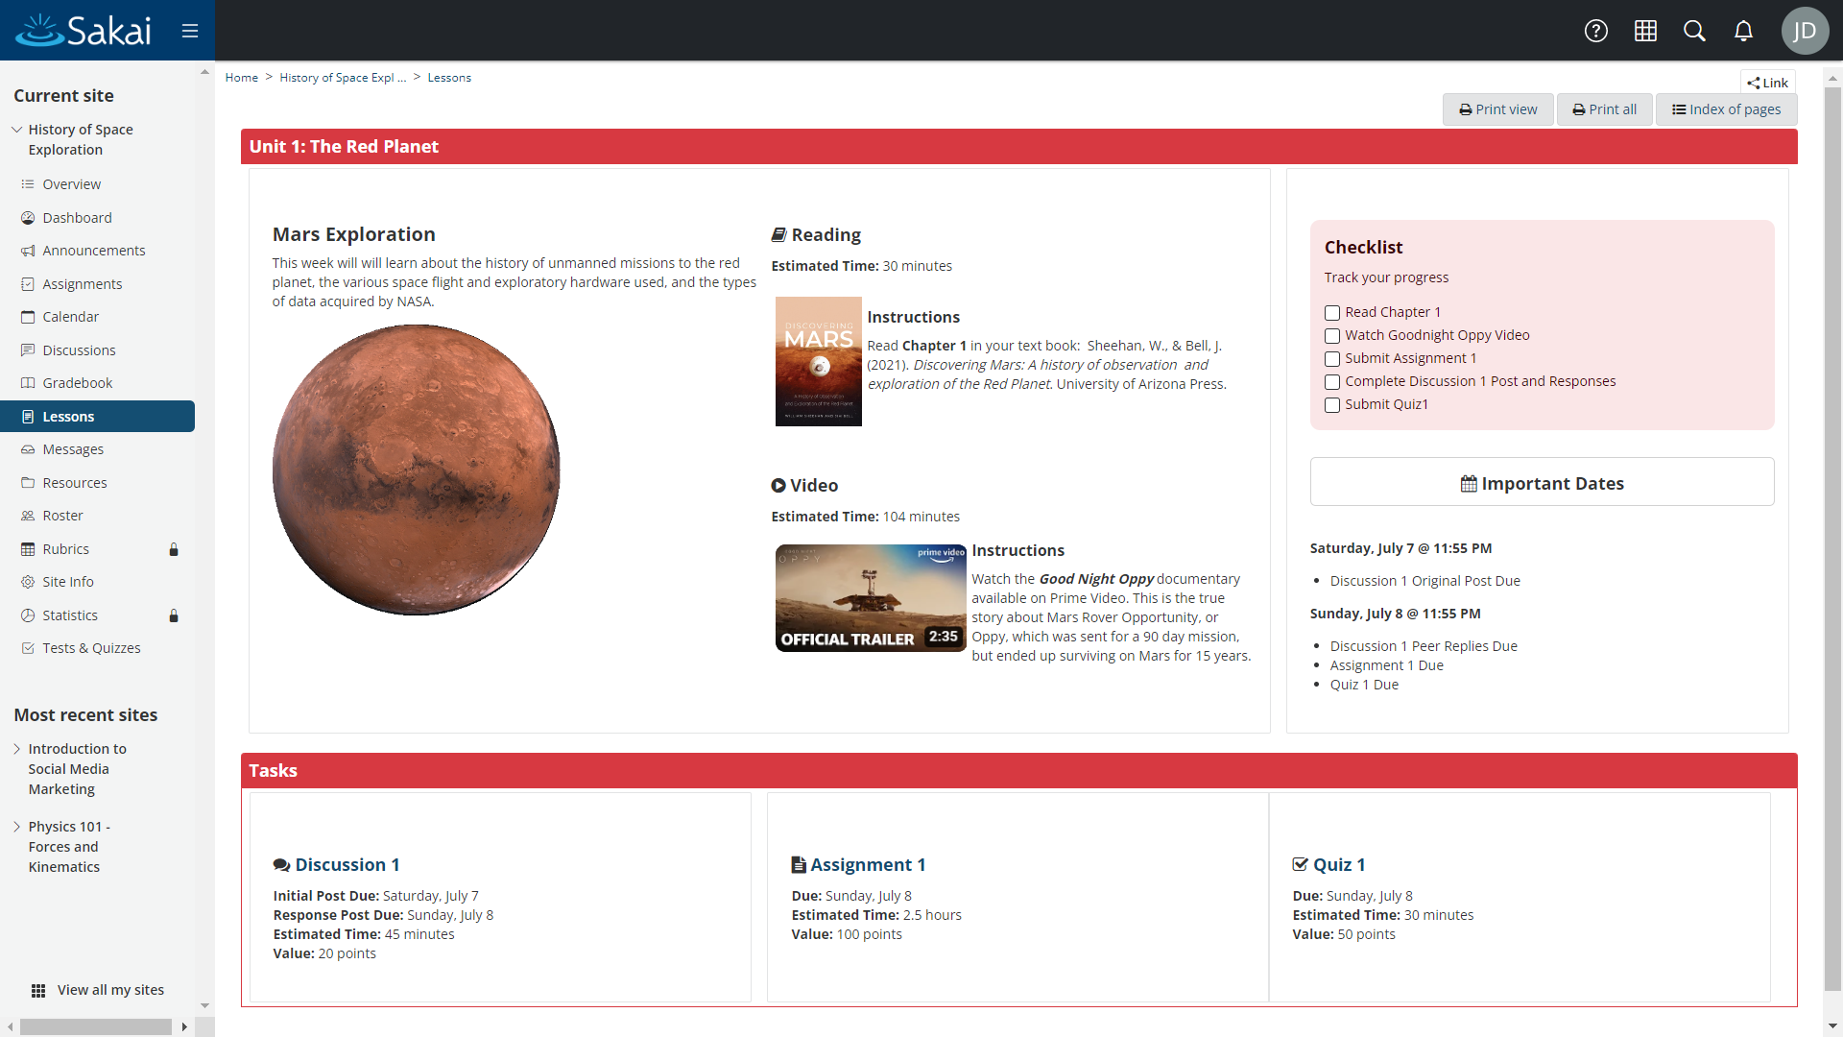
Online Learning Content
Sakai Lessons: Advanced content authoring
#NERCOMP23
Notes:
SD

Slide 21
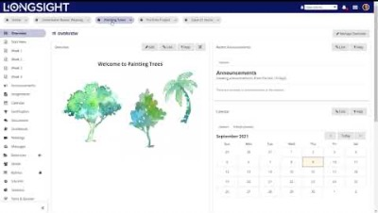
Online Learning Content

Slide 22
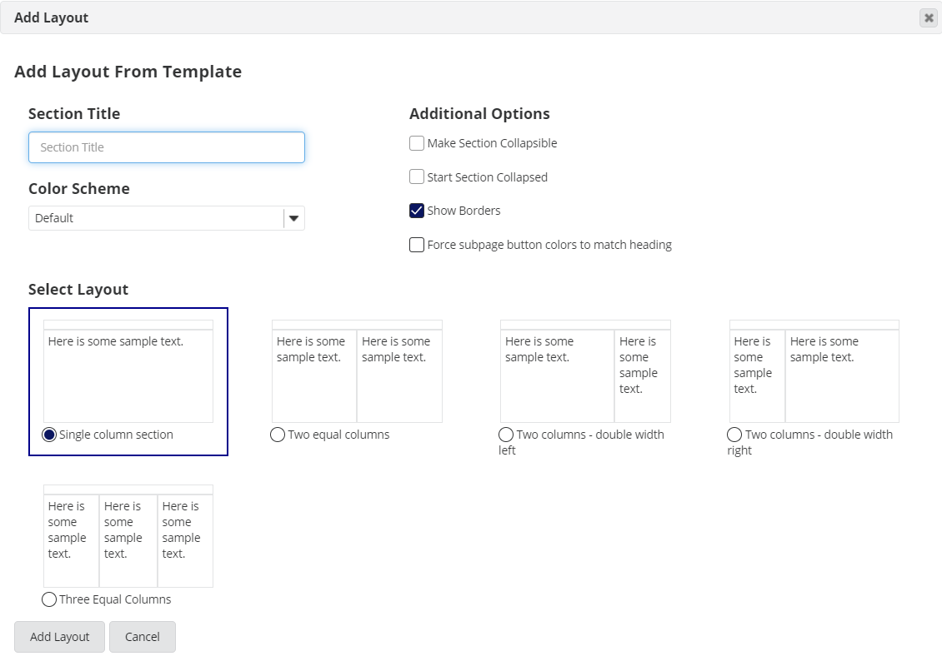
Online Learning Content
Sakai Lessons: Advanced content authoring
#NERCOMP23
Notes:
SD

Slide 23
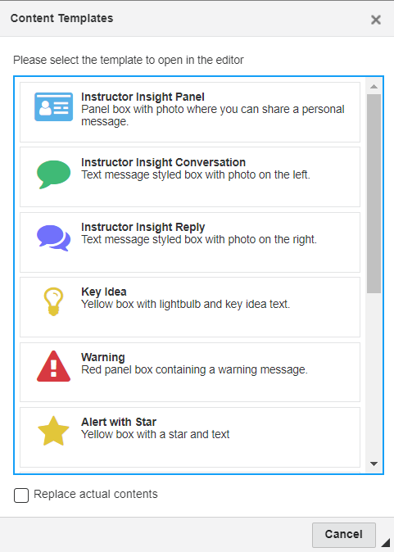
Online Learning Content
Sakai Lessons: Advanced content authoring
#NERCOMP23
Notes:
SD

Slide 24
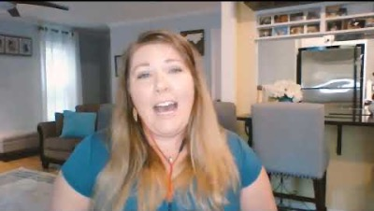
Collaboration & Deep Learning
Sakai Lessons: Deep student learning
Learn more: bit.ly/Sakai-meaningful-learning
#NERCOMP23
#NERCOMP23
Notes:
SD

Slide 25
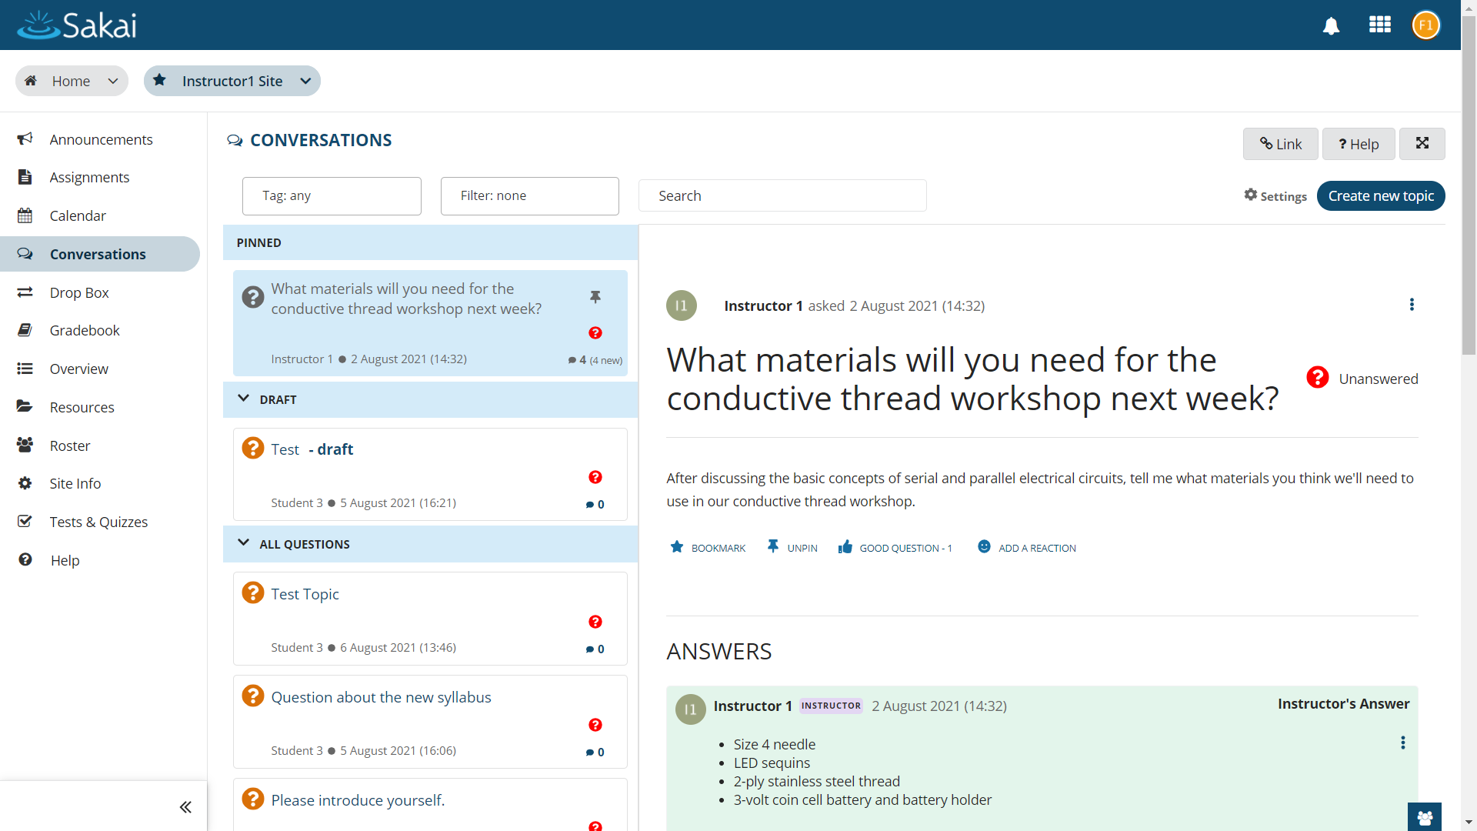
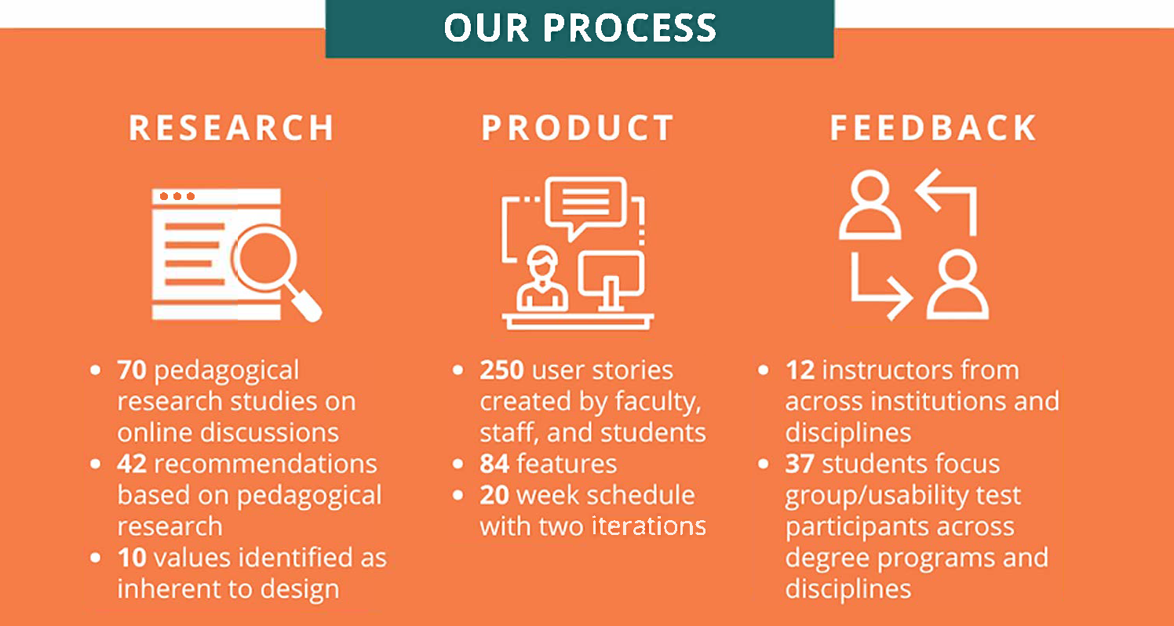
Collaboration & Conversation
Sakai innovates by soliciting the best ideas of instructors and students.
Learn more: bit.ly/Sakai-Conversations
#NERCOMP23
Notes:
SD

Slide 26

Collaboration & Conversation
#NERCOMP23
Notes:
SD

Slide 27
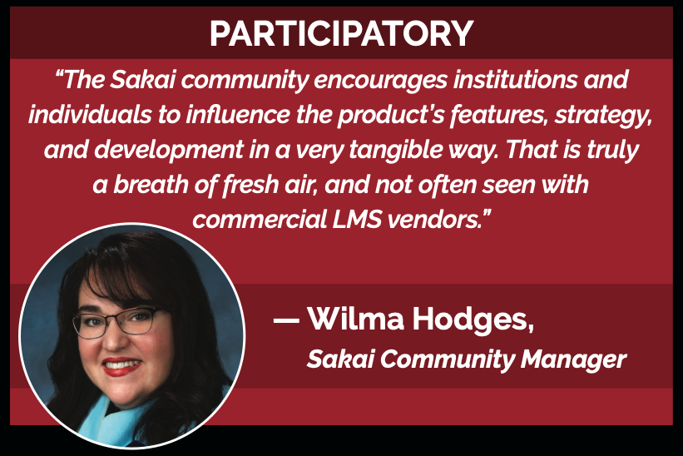
#NERCOMP23
Notes:
Sakai’s innovation is participatory. Sakai Community members get a real say in how the product evolves over time. Among LMS’s, that’s unique to Sakai.

Slide 28

Rapidly evolving… and Responsive
Sakai’s Roadmap…
Innovative, Responsive, and Open.
Learn more:
bit.ly/Sakai-Open-Roadmap
#NERCOMP23
Notes:
Our 3-year open roadmap emerges from a highly collaborative process each winter.
Community members get several opportunities to comment on, and help shape, this roadmap as it moves from draft to adoption.
We make this roadmap available to all, and you can review it at the link on this slide.
We’re more open than any of our competitors about the exciting stuff that’s to come.

Slide 29
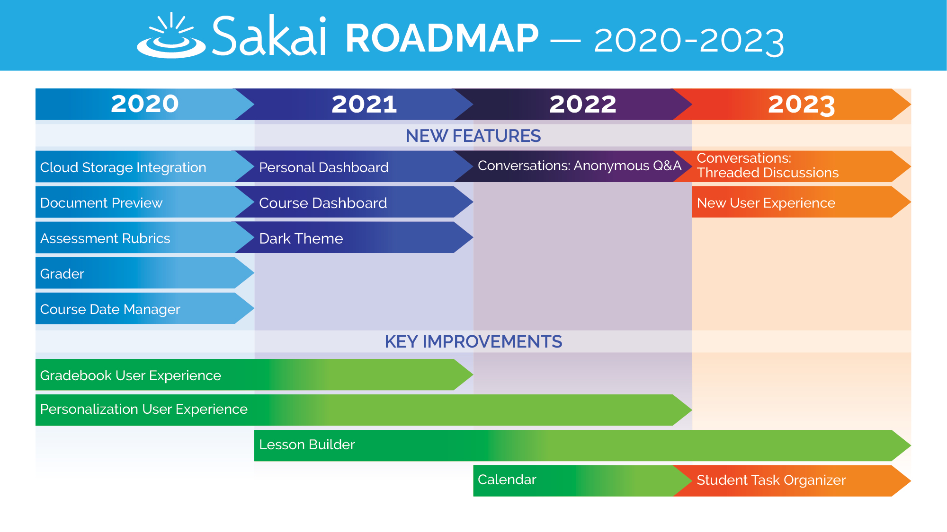
Rapidly Evolving… and Delivering
Learn more:
bit.ly/ Sakai-Open-Roadmap
#NERCOMP23
Notes:
Here’s a summary of the forward progress that’s been spurred by the commitment to our roadmap over the past few years.
Looking ahead into the near future, there’s lots more to come.
Every year since 2020 has seen significant expansion of Sakai’s capabilities, plus meaningful improvements to existing tools.
In 2020, Sakai gained 5 new major features, 2021 saw a major new tool and lots of key usability enhancements, and 2022 is the year of release for Sakai Conversations.
Looking ahead to 2023, there will be further improvements to Conversations, new ways for students to keep themselves organized, and an all new Meetings Manager tool that will make it easier to organize synchronous online discussions.

Slide 30
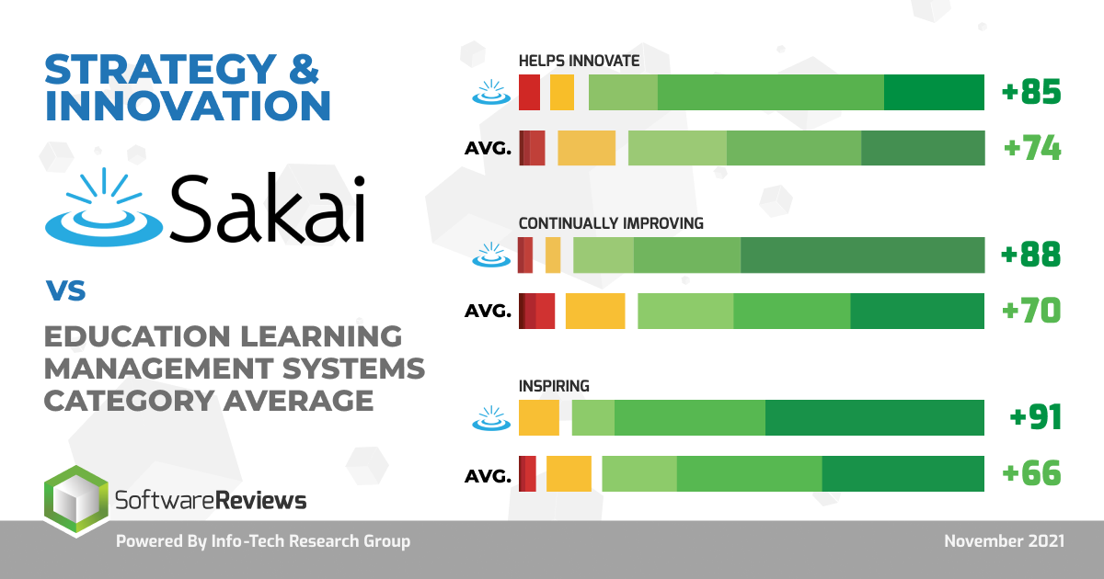
Most Innovative
#NERCOMP23
Notes:
Based upon a market study of reviews from more than 1000 expert LMS users, Sakai experts already view Sakai more positively than Canvas experts view Canvas, etc.
This is also true of our innovation trajectory. According to this analysis, Sakai’s pattern of innovation and improvement is incredibly strong.

Slide 31
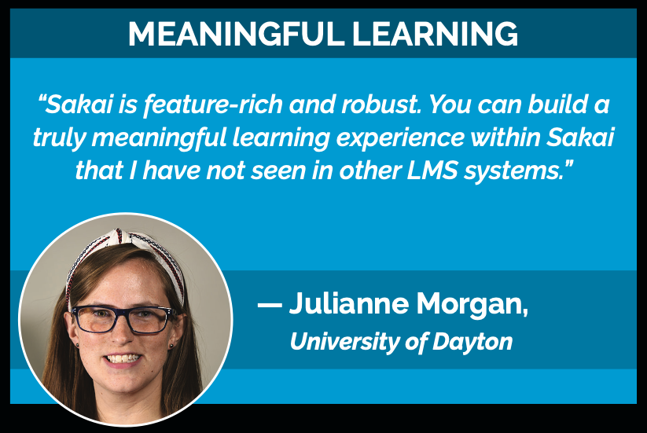
#NERCOMP23
Notes:
SD

Slide 32
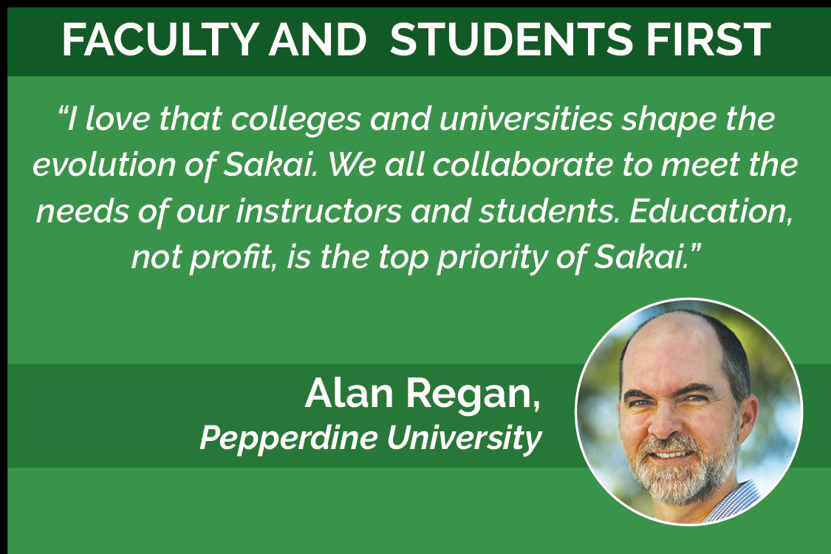
#NERCOMP23
Notes:
SD

Slide 33

#NERCOMP23
Notes:
Finally, let me say a few words about why Sakai is Best for Privacy.
Because Sakai is open source, institutions can maintain control of their student data by running Sakai in an on-campus data center or in the cloud with full contractual control of student educational records.
How do we make this possible?
With expert commercial affiilates who can help. Like my firm, Longsight.

Slide 34



Sakai at scale since 2005 ◉ 100 institutions hosted ◉ Deep expertise and a personal touch
Expert
Consultation
Managed services in your data center
Cloud
hosting
A Broad Array of Sakai Services
“Longsight’s expertise and professionalism has made a significant impact and inspired great confidence at the University of Dayton.”
— David Bauer, Director, University of Dayton
“[Longsight] exemplifies one of the best relationships we’ve had with a vendor. They’re collaborative in nature and they’re responsive….”
— Alan Regan, Director, Pepperdine University
#NERCOMP23
Notes:
Let me say a few words about Longsight.
Some of you in this room remember me when I was at Brandeis University previously for 12 years in an IT leadership role, and that institution never had a service provider like Longsight.
We’re giving you today the wide range of Sakai options that you’ll need tomorrow – from expert consultation when you need it to full Sakai hosting in the Amazon cloud. And Longsight service agreements give you full contractual control of your student data.
We’re leaders in the Sakai Community, coordinating Marketing, Product, Technical Release, Community engagement, and more.
Everyone on our team has 10+ years of experience working with Sakai.
Several have been around since the Sakai’s birth in 2005.
I’m the new guy, with 5 years at Longsight and 20 years previously in higher education.
We’re small, with minimal turnover.
When you work with Longsight, you know us all by name and we know your team.
It’s an unusual approach, and it’s how we make a difference for colleges and universities.
—-----------
Hosting clients -- Longsight.
Illinois State University. 21k students.
Brock University. 19k students.
Duke University. 15k students.
Integral part of Sakai Community.
Nearly half of Sakai management team (PMC). 6 of 15 PMC member represented.
Lead in key areas: Overall community alignment, Internationalization, Marketing, Product, Release, Security.
Deep Sakai expertise & functional knowledge.
Combined: Many decades of Sakai experience.
We’ve worked in higher education, so we understand your needs.

Slide 35
Questions?
Learn more:
SakaiLMS: www.sakailms.org
SakaiPlus: plus@sakailms.org
#NERCOMP23
Notes:
SD

Slide 36

Back pocket
`
#NERCOMP23
Notes:
Let me turn things back over to my mad scientist friend here for a quick look at Sakai Plus.

Slide 37
#NERCOMP23

Slide 38
Contact Information
NOTE: This presentation leaves copyright of the content to the presenter. Unless otherwise noted in the materials, uploaded content carries the Creative Commons Attribution 4.0 International (CC BY 4.0), which grants usage to the general public, with appropriate credit to the author.
#NERCOMP23

